Slide 1
Impressed with
IT4K12 - Jarrod Bell - SD60
twitter @jbellsd60
jbell@prn.bc.ca
image: http://s.wordpress.org/about/images/logos/wordpress-logo-stacked-rgb.png

Slide 2
Wordpress
Free Open Source Software
Community Driven
Freely available themes and plugins
free and paid support, hosting options
Included in many hosted services as an option in cpanel / config tools along with others like Drupal, Joomla etc.

Slide 3
Options Options Options
Drupal - http://edcampleadership.deltasd.bc.ca/
Joomla - http://www.neat.ca
Wordpress - what we'll look at a little today from install to use

Slide 4
What do I Need?
Host that supports
Your own web server and a static IP
how I started
Apache, MySQL, PHP (xampp, lamp, wamp)
IIS
database, and database user & pass

Slide 5
Time
can train end users in under an hour
familiar to users if they have been using services like edublogs.org, wordpress.com, kidblog.org
on to the famous five minute install (assuming your web server is set up)

Slide 6
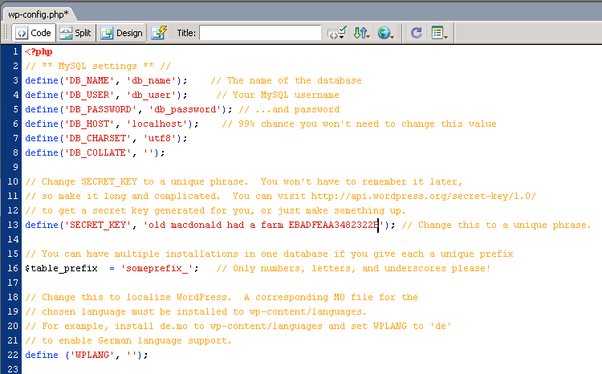
Install
load the package to a web folder
update the wp-config-sample.php file with your info
save as wp-config.php in the root folder for the site

Slide 7
Install
www.prn.bc.ca/projects/it4k12

Slide 8
Posts and Pages
What's the difference between a Post and a Page?

Slide 9
Widgets
example: tag cloud - http://www.prn.bc.ca/ww/

Slide 10
Menus
menus have evolved!

Slide 11
Themes
Freely available from wordpress.org
Or elsewhere - buyer beware!

Slide 12
Plugins
a couple of suggestions
security
spam

Slide 13
Updates
backup and push the button
or just push the button (hold your breath and hope you didn't need to backup - never had a problem though)

Slide 14
Question
If we are asking schools and teachers to personalize learning - shouldn't we allow them web tools they can personalize too?

Slide 15
Next thing to learn
Wordpress MultiSite (used to be multi-user)
Many instances managed from one admin console
tie it to user directory system (users create own blog)
UBC and SD73 as examples

Slide 16
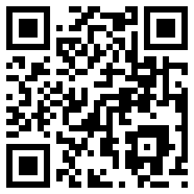
Thank you!
@jbellsd60
jbell@prn.bc.ca
250-262-6011
Slides will be available via slideshare on www.prn.bc.ca/ts
QR Code generated at http://qrcode.kaywa.com/

