Slide 1

Regional Working Session
Curriculum and Assessment
Framework

Slide 2

Purposes of the Regional Working Session
Update on Curriculum and Assessment Framework
Get feedback

Slide 3

Context for the Work
Need for changes to curriculum and assessment
Actions to date
Where we are now

Slide 4

Curriculum
Context
Competencies
Phases K-12
Prototype
Notes:
opportunity to apply competencies

Slide 5
Context for Curriculum
Size: create space to allow creative uses
Nature: focus on competencies and concepts
Organization: standards for areas of learning
How curriculum is experienced:
  standards combined and integrated in various ways
  courses if necessary, but not necessarily courses

Slide 6
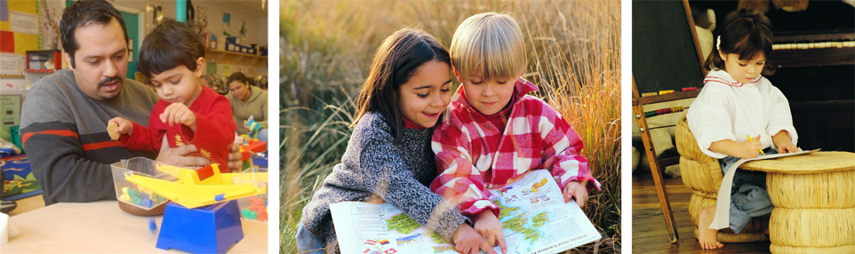
Three Phases of Learning
Foundation Years: K-5?
Middle Years: 6-9? 6-10?
Graduation Years: 10-12? 11-12?

Slide 7

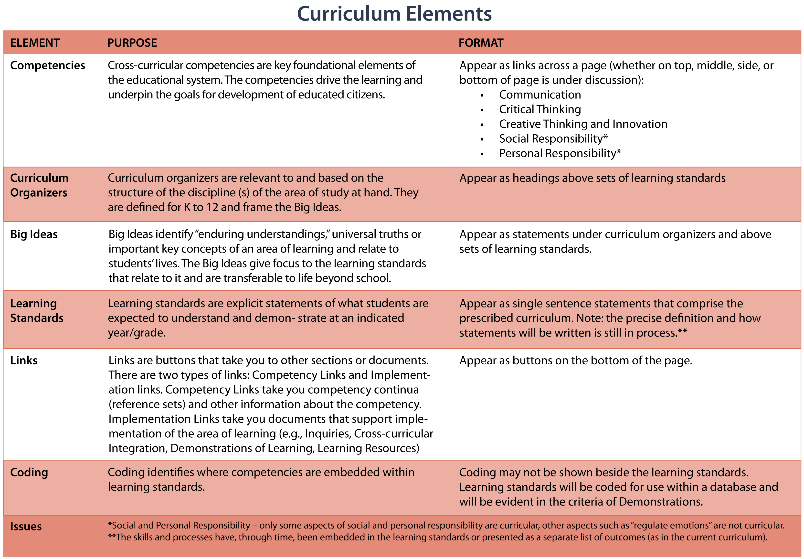

Slide 8


Slide 9
Graduation Years: Possible Organization
Scientific Inquiry
Social Sciences
SI 1
SI 2
SI 3
SI 4
SS 1
SS 2
SS 3

Slide 10
Cross-Curricular Competencies
• Communication
Critical thinking
Creative thinking and innovation
Personal responsibility and well-being
Social responsibility
Continua developed by teams of teachers will support assessment and reporting

Slide 11

Curriculum Organizers
Curriculum organizers identify the structure of
the curriculum as it relates to the discipline(s)
it is based upon
Identity, Society and Culture Governance Economy & Technology Environment

Slide 12
Competencies
Highlights that competencies are a key feature of
the curriculum and make clear what skills/processes of each competency are focused on that year.
Communication
(C)
Critical Thinking
(CT)
Creative Thinking and Innovation
(CI)
Personal Responsibility
(PR)
Social Responsibility
[SR]

Slide 13
Big Ideas and Learning Standards
Big Ideas identify the enduring understandings or universal truths of the area of learning; Learning standards describe what students are expected to understand and demonstrate
Contact with others influences peoples’
distinct cultural beliefs.
examine the distinct cultures of First Nations groups living in British Columbia prior to
contact with Europeans
C , CT, GC
appraise the effects of early contact between Aboriginal societies and European explorers and settlers
CT, GC
Governance structures
affect people’s rights and responsibilities.
compare pre-contact governance structures of Aboriginal communities with those of early European settlements in BC and Canada
C , CT, GC
assess the impact of Canadian governance on Aboriginal people’s rights
CT, GC
Through time humans have faced challenges
and met needs by developing new systems and technologies.
Geography and way
of life affect one another.
investigate technologies developed by Aboriginal
people
C, GC
describe early trading
systems of Aboriginal
cultures in BC
C
analyze Aboriginal peoples’ historic and contemporary relationship with the land and natural resources
C, CT, GC, SR, ES
predict the impact of all Canadians adopting
Aboriginal world views
CI, GC, PR, ES

Slide 14
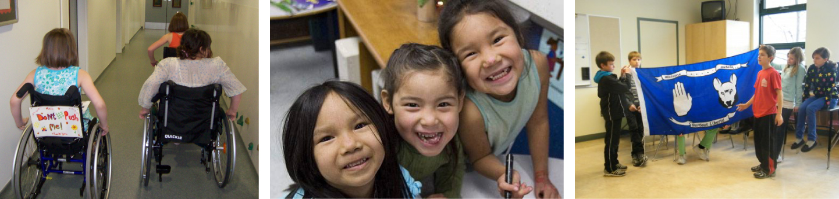
Links
Links provide additional information (written, visual, audio-visual) to clarify and support the curriculum, for example:
  Example inquiries and cross-curricular projects
  Demonstrations of learning

Slide 15
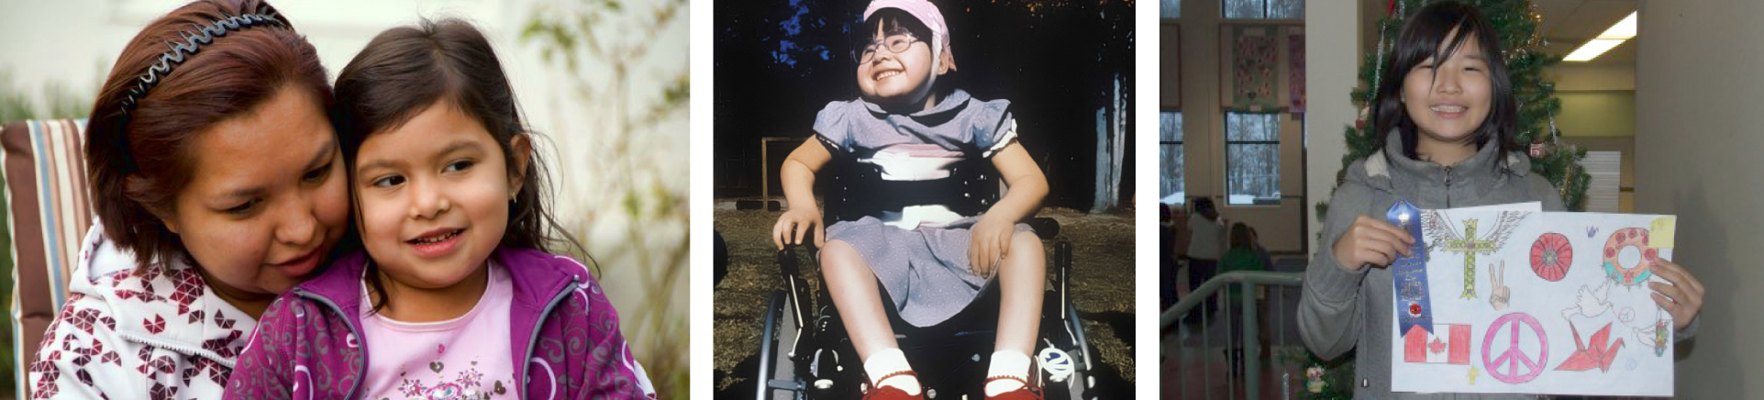
Curriculum Feedback
Competencies
  What is your reaction to the working list of competencies?
Curriculum Prototype
  What questions or comments do you have about the prototype?

Slide 16

Assessment

Slide 17
Proposed Directions for Assessment
Student Assessment
Multiple approaches, emphasizing student self-assessment and assessment for learning
Developmental continua and exemplars for cross-curricular competencies
Example demonstrations of learning
Refreshing existing performance standards

Slide 18
Proposed Directions for Assessment
Large-Scale Assessment
There will be provincial assessments at elementary and secondary grades—what they will look like is TBD.
Will be designed to support learning.
Incorporate a wider variety of formats than present, including performance tasks, structured inquiries, classroom-based assessments.
In elementary, both foundation skills and competencies will be assessed.
In secondary, increased emphasis on competencies and key areas of learning (will tie in to discussions on graduation requirements).

Slide 19
Reporting
Communicating Student
Learning K-9

Slide 20
Communicating Student Learning:
Directions and Feedback to Date
Shift from “reporting” to “communicating student learning”
Reporting on cross-curricular competencies and areas of learning
Ongoing communication with provincial guidelines and supports
Formal, written summative reporting at key times in the year
Clear performance standards-based language
No letter grades for K-9; varied views for Grades 10-12.
No percentages - varied views

Slide 21

Graduation Requirements
HOW TO PERSONALIZE BC’S GRAD PROGRAM?
Need your input!

Slide 22
Current Grad Requirements 2011/2012
48 credits from required courses
  Planning 10
  a Language Arts 10*
  a Language Arts 11
  a Language Arts 12*
  a Mathematics 10*
  a Mathematics 11 or 12
  a Fine Arts and/or Applied Skills 10, 11 or 12
28 credits from elective courses, and
4 credits from Graduation Transitions
  Social Studies 10
  a Social Studies 11* or 12
  Science 10*
  a Science 11 or 12
  Physical Education 10
80 Credits Total
Of the 80 credits for graduation, at least 16 must be at the Grade 12 level, including a Grade 12 Language Arts course. Others may be required or elective courses.
5 required exams (in courses noted by *)

Slide 23
Adult Grad Requirements 2011/2012
20 credits from required courses
  a Language Arts 12*
  a Mathematics 11 or 12
  a Social Studies 11* or 12
  And two Grade 12 level
  OR
  3 Grade 12 level ministry authorized courses
20 Credits Total
Only Ministry authorized courses allowed,
no BAA, IDS, etc.
Language Arts 12 exams are optional

Slide 24
Graduation Feedback Received to Date
Graduation based on a demonstration of competencies rather than course completion
A final, competency-based exit assessment required for graduation
A project-based, cross-curricular capstone project required for graduation
Demonstration of learning through a collection of learner’s work
A focus on the community – involving learners in the community, and preparing them for life after K-12

Slide 25
Graduation Feedback Received to Date
Extend opportunities for external credentials
Choice and flexibility for learners to meet graduation requirements, including academic and non-academic options/pathways (e.g., trades, technology)
Graduation as a minimum standard. Learners would be able to go beyond graduation to meet personal goals, e.g., advanced math for university prep, trades training
Move away from grade 10 and 11 examinations in their current form.

Slide 26
Response to Assessment, Reporting, and Graduation Feedback
What resonates with you about feedback received
to date?
    What works in your context?
    What would you change?
    How would you change it?
To what extent would the proposed changes clear
the pathway for innovation in your district?
Do you have any other advice in these areas?

Slide 27

Wrap-up: Next Steps
Continuous ongoing process
Further opportunities to be involved

Slide 28
Further Contact
Nancy Walt
nancy.walt@gov.bc.ca
Dean Goodman
dean.goodman@gov.bc.ca

Slide 29


Stay Engaged
bcedplan.ca

